Slide 1
Generative adversarial networks
Abdul Samad
Adapted from Prof. Simon Prince

Slide 2
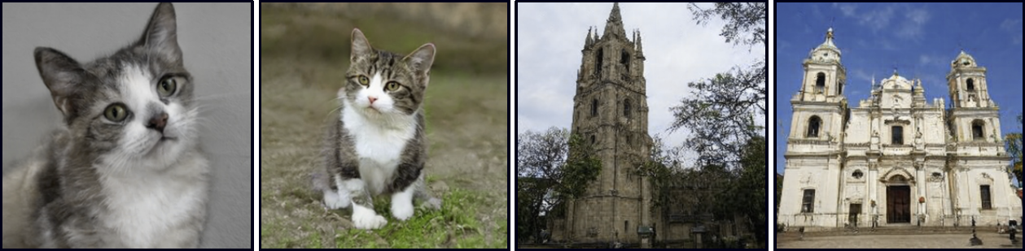
Generative adversarial models

Slide 3
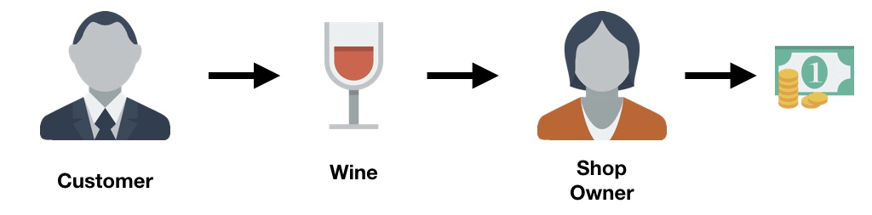
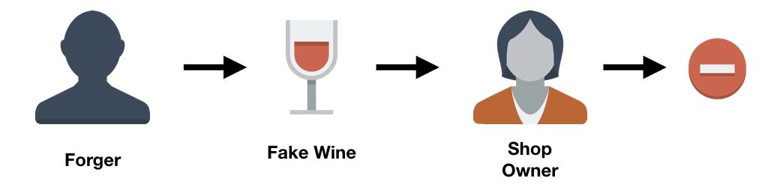
Analogy

Slide 4
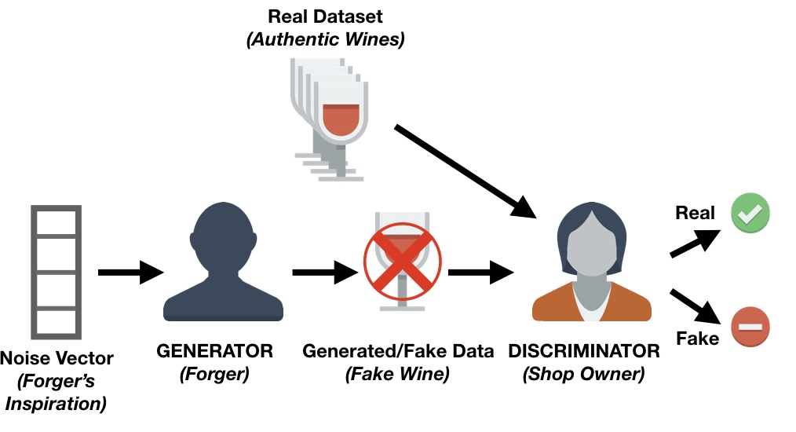
Analogy

Slide 5
Latent variable models
Latent variable models map a random “latent” variable to create a new data sample
In GANs, this is called the generator:
Notes:
We aim to generate new samples $\{x_{j}^{∗} \}$ that are drawn from the same distribution as a set of real training data$\{x_{i}\}$. A single new sample $x_{j}^{∗}$ is generated by (i) choosing a latent variable $z_{j}$ from a simple base distribution (e.g., a standard normal) and then (ii) passing this data through a network $x_{j}^{∗}$ = $g[z_{j} , θ]$ with parameters θ. This network is known as the generator. During the learning process, the goal is to find parameters θ so that the samples $x_{j}^{∗}$ look “similar” to the real data $\{x_{i}\}$

Slide 6
Generative adversarial models
GAN loss function
DCGAN results and problems
Tricks for improving performance
Conditional GANs
Image translation models
StyleGAN

Slide 7
GAN example

Slide 8
GAN example
Discriminator

Slide 9
GAN example

Slide 10
GAN example

Slide 11
GAN cost function
Discriminator uses standard cross entropy loss:

Slide 12
GAN cost function
Discriminator uses standard cross entropy loss:
Discriminator: generated samples, y = 0, real examples, y = 1:

Slide 13
GAN cost function
Discriminator uses standard cross entropy loss:
Discriminator: generated samples, y = 0, real examples, y = 1:
Generator loss: make generated samples more likely under discriminator (i.e. make discriminator loss larger)

Slide 14
GAN Cost function
Can divide into two parts:

Slide 15
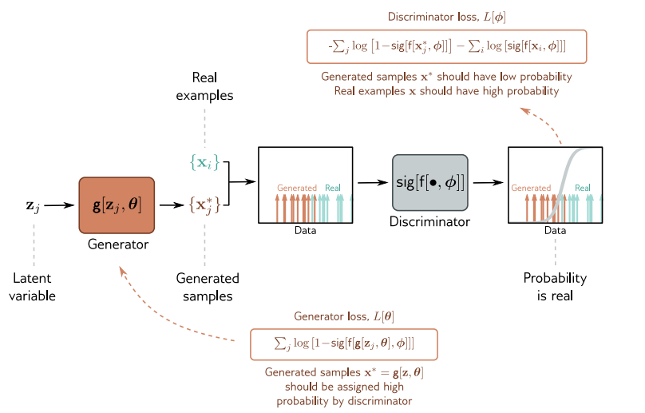
GAN loss function

Slide 16
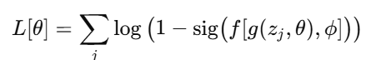
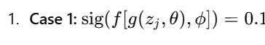
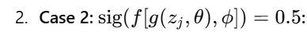
Generator loss

Slide 17
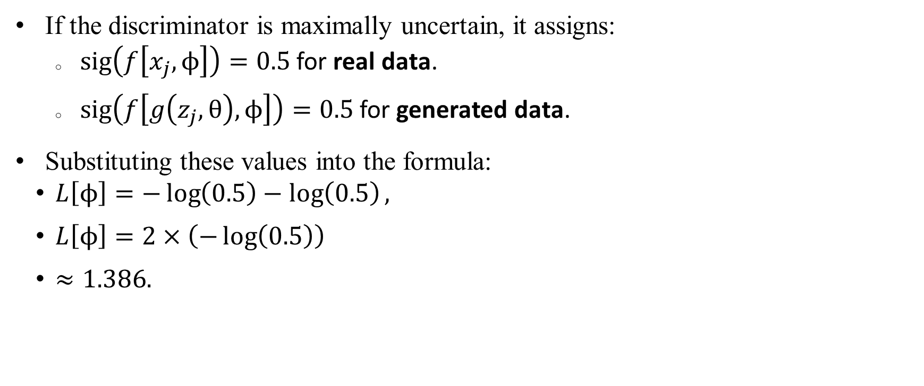
Numerical insight into descriminator loss
If the discriminator is maximally uncertain, it assigns:
$\text{sig}\left(f\left[x_{j},ϕ\right]\right)=0.5$ for real data.
$\text{sig}\left(f\left[g\left(z_{j},θ\right),ϕ\right]\right)=0.5$ for generated data.
Substituting these values into the formula:
$L\left[ϕ\right]=−\log\left(0.5\right)−\log\left(0.5\right),$
$L\left[ϕ\right]=2×\left(−\log\left(0.5\right)\right)$
$≈1.386.$

Slide 18
Deep Convolutional (DC) GAN
Notes:
The tanh function is ideal for the generator's output layer because:
It maps directly to the normalized pixel range [−1,1][-1, 1][−1,1].
It ensures symmetry around zero for better gradient flow.
It prevents vanishing gradients compared to sigmoid.
It produces smooth, realistic outputs essential for image generation.

Slide 19
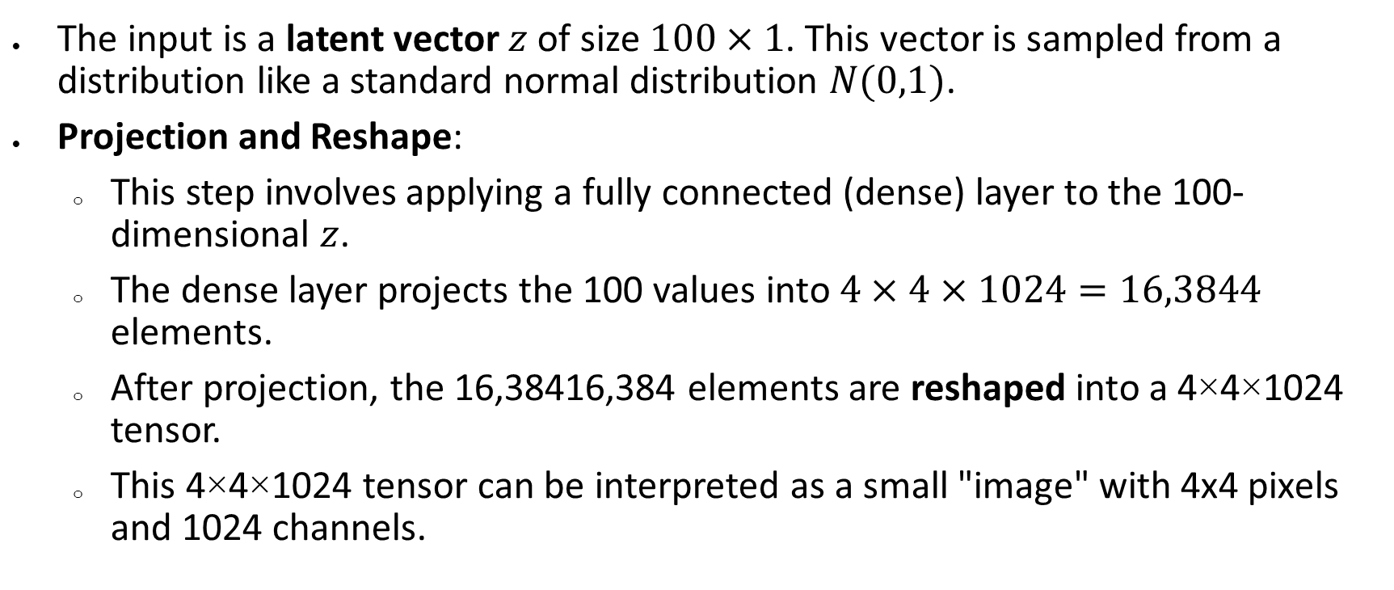
Project and Reshape
The input is a latent vector $z$ of size $100×1$. This vector is sampled from a distribution like a standard normal distribution $N(0,1)$.
Projection and Reshape:
This step involves applying a fully connected (dense) layer to the 100-dimensional $z$.
The dense layer projects the 100 values into $4×4×1024=16,3844$ elements.
After projection, the 16,38416,384 elements are reshaped into a 4×4×1024 tensor.
This 4×4×1024 tensor can be interpreted as a small "image" with 4x4 pixels and 1024 channels.

Slide 20
DC GAN Results

Slide 21
Mode collapse
Training GANs is difficult. Often fails.
Notes:
A common failure mode is that the generator makes plausible samples, but these only represent a subset of the data (e.g., for faces, it might never generate faces with beards). This is known as mode dropping. An extreme version of this phenomenon can occur where the generator entirely or mostly ignores the latent variables z and collapses all samples to one or a few points; this is known as mode collapse

Slide 22
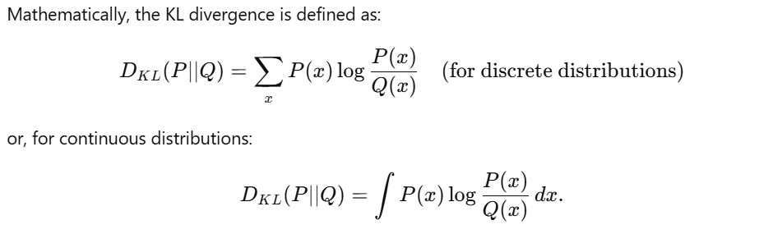
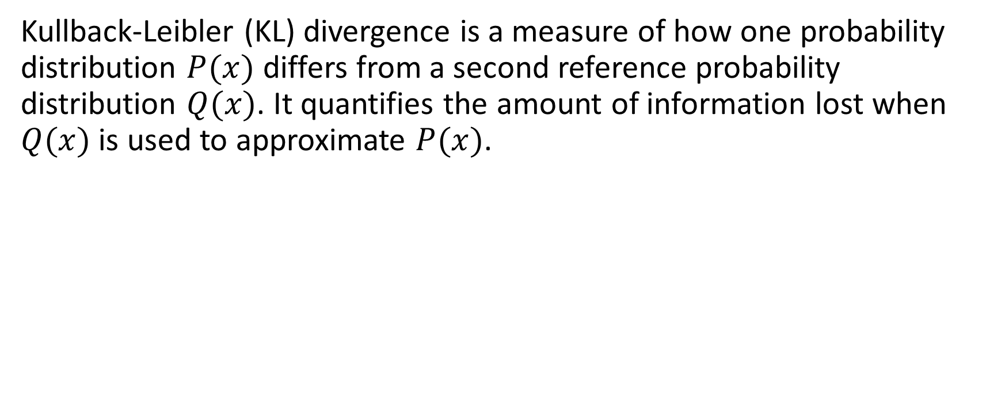
Kullback-Leibler (KL) divergence
Kullback-Leibler (KL) divergence is a measure of how one probability distribution $P(x)$ differs from a second reference probability distribution $Q(x)$. It quantifies the amount of information lost when $Q(x)$ is used to approximate $P(x)$.

Slide 23
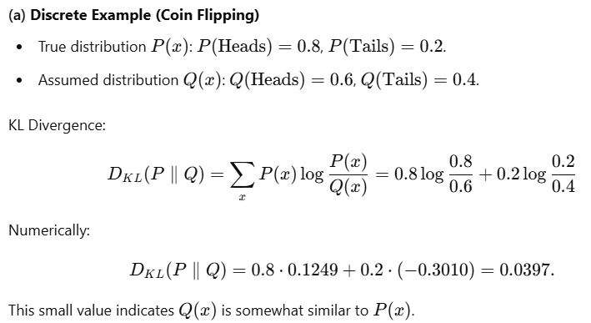
Example

Slide 24
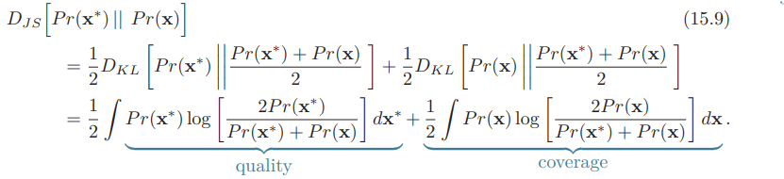
Analysis of the GAN loss function

Slide 25
GAN training instability

Slide 26
GAN training instability
Fix generator and continue training discriminator, then generator gradients disappear.

Slide 27
Wasserstein GAN loss function
Original function:
Wasserstein GAN:
subject to:

Slide 28
Generative adversarial models
GAN loss function
DCGAN results and problems
Tricks for improving performance
Conditional GANs
Image translation models
StyleGAN

Slide 29
Trick 1: Progressive growing

Slide 30
Trick 2: Minibatch discrimination
Add in statistics across minibatch as input to discriminator
Forces generated batch to have similar variation to real batch

Slide 31
Trick 3: Truncation
Only choose random values of latent variables that are less than a threshold $τ$.

Slide 32
Example results

Slide 33
Interpolation

Slide 34
Generative adversarial models
GAN loss function
DCGAN results and problems
Tricks for improving performance
Conditional GANs
Image translation models
StyleGAN

Slide 35
Conditional GAN models

Slide 36
Conditional GAN models

Slide 37
ACGAN results

Slide 38
Conditional GAN models

Slide 39
InfoGAN results

Slide 40
Generative adversarial models
GAN loss function
DCGAN results and problems
Tricks for improving performance
Conditional GANs
Image translation models
StyleGAN

Slide 41
Image translation: Pix2Pix

Slide 42
Image translation: Pix2Pix

Slide 43
Image translation: SRGAN

Slide 44
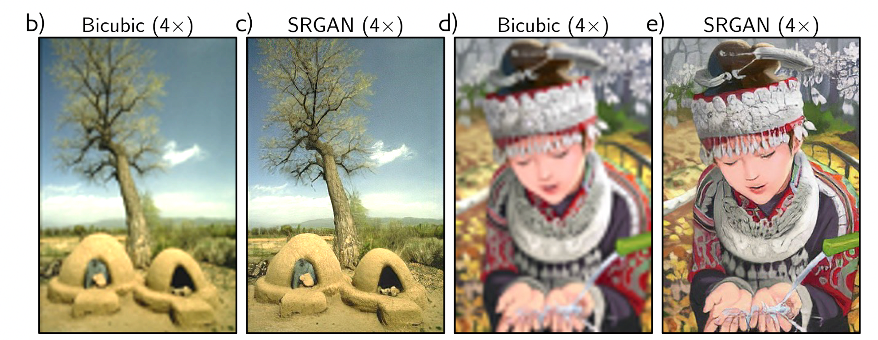
Image translation: SRGAN

Slide 45
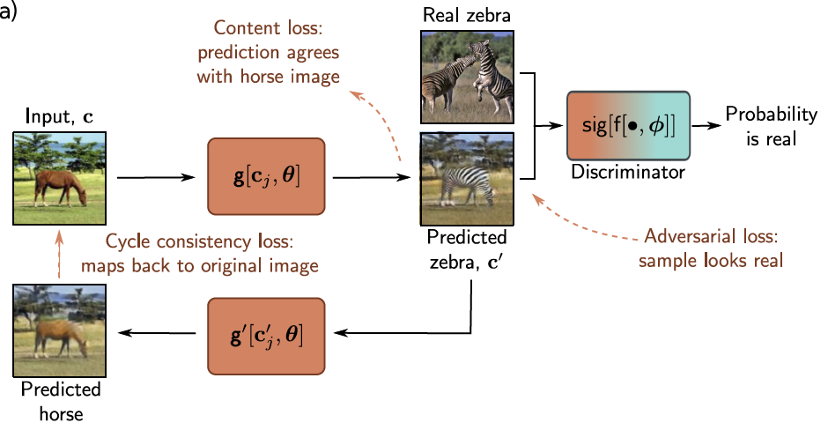
Image translation: CycleGAN

Slide 46
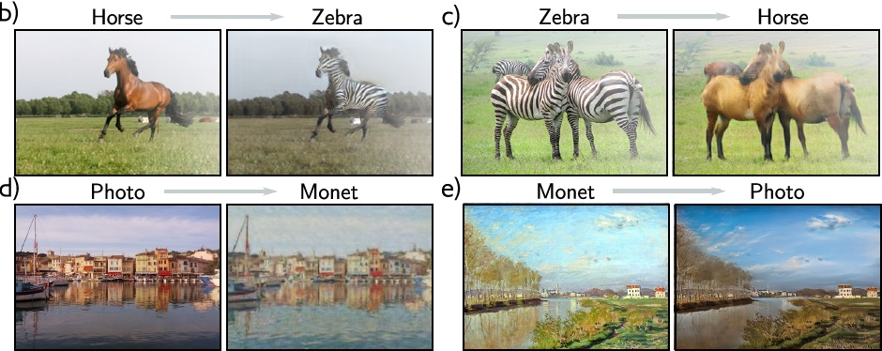
Image translation: CycleGAN

Slide 47
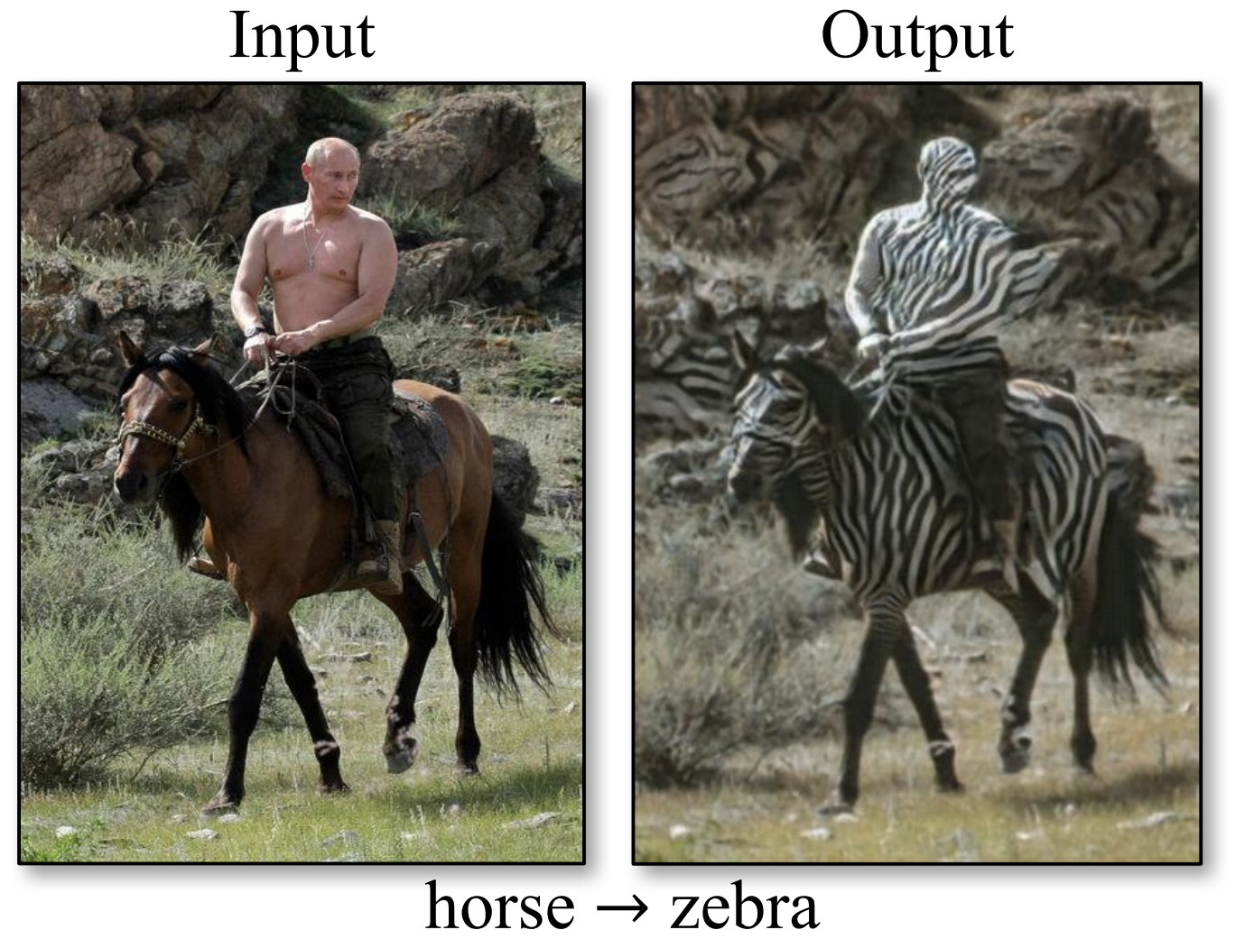

Slide 48
Generative adversarial models
GAN loss function
DCGAN results and problems
Tricks for improving performance
Conditional GANs
Image translation models
StyleGAN

Slide 49
Style GAN

Slide 50
Style GAN results

